Slide 1

Engineering
Chemistry
Dr. A. Ravikrishnan
M.Sc., M.Phil., M.Ed., Ph.D., MISTE., MILCS.,

Slide 2
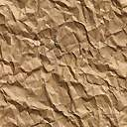
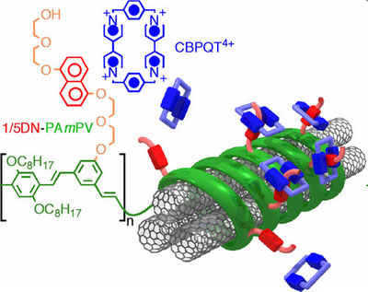
Chapter 7
Nanochemistry

Slide 3
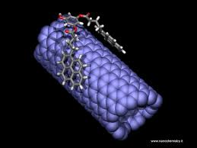

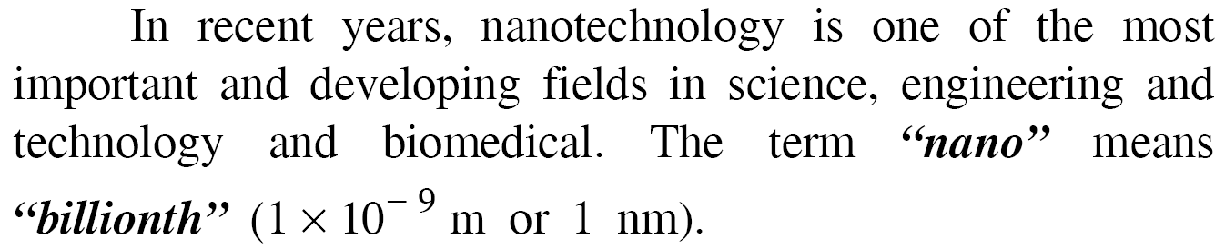
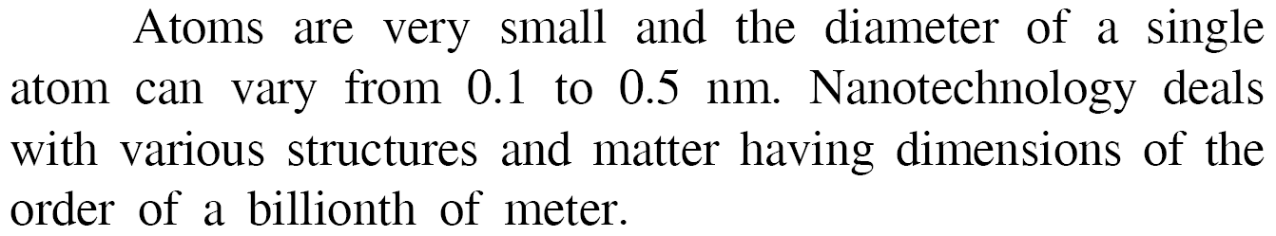

Slide 4


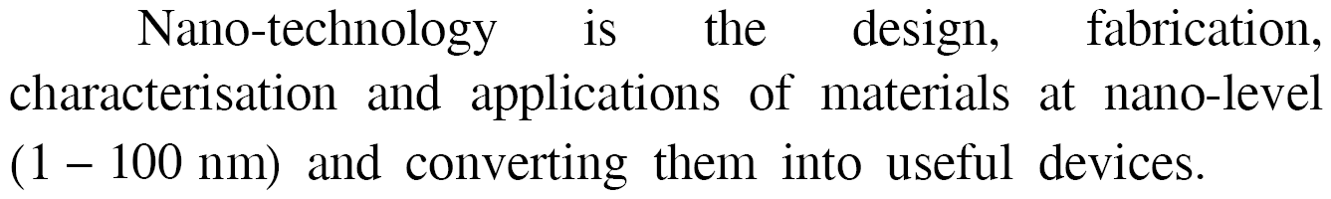

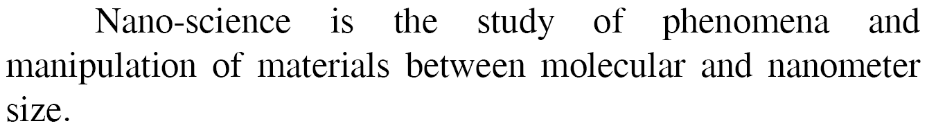

Slide 5


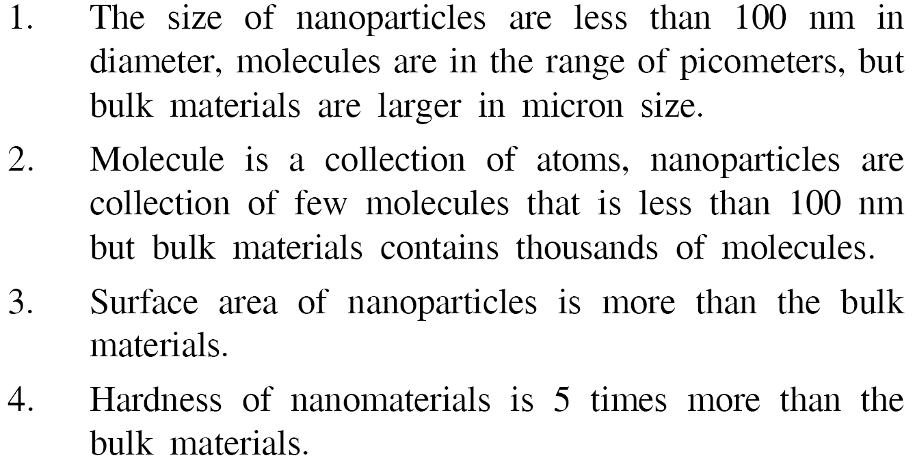

Slide 6
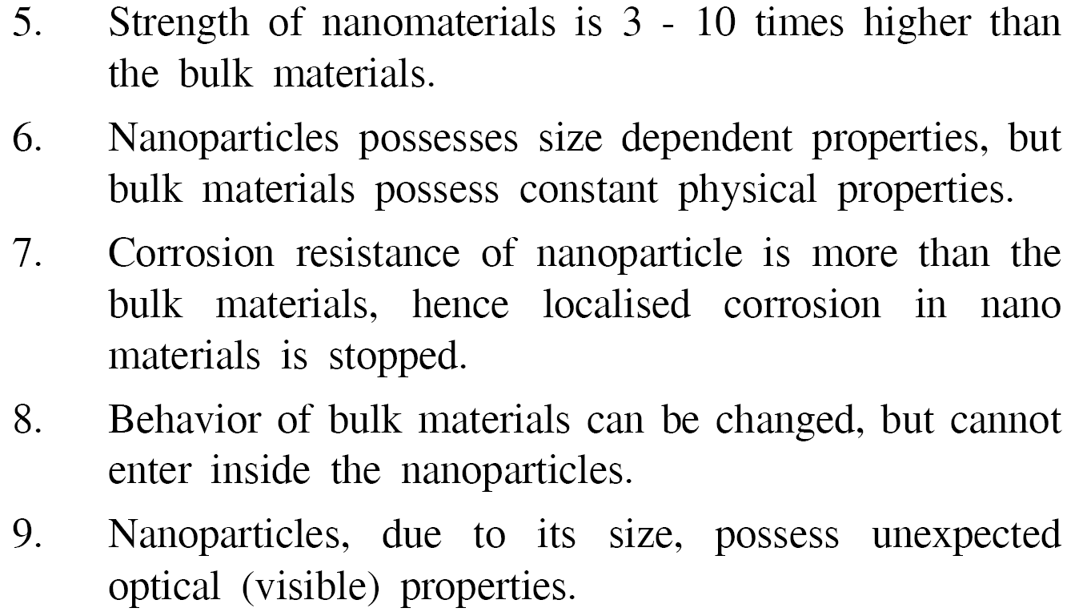

Slide 7
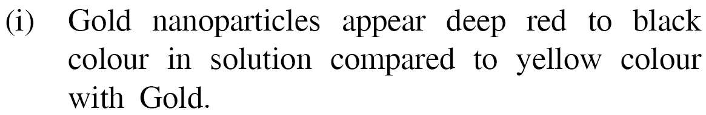
E amples

Slide 8
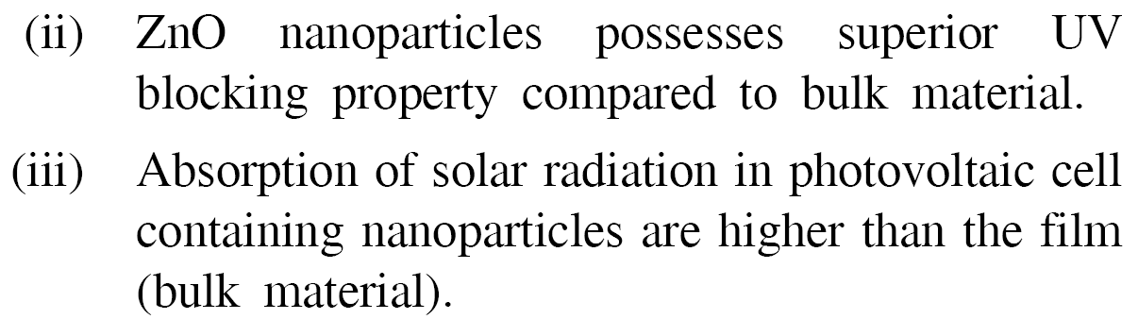
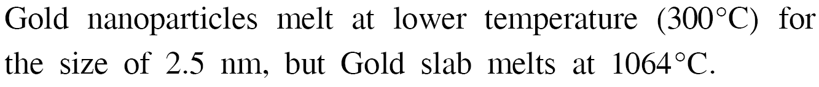
E amples

Slide 9
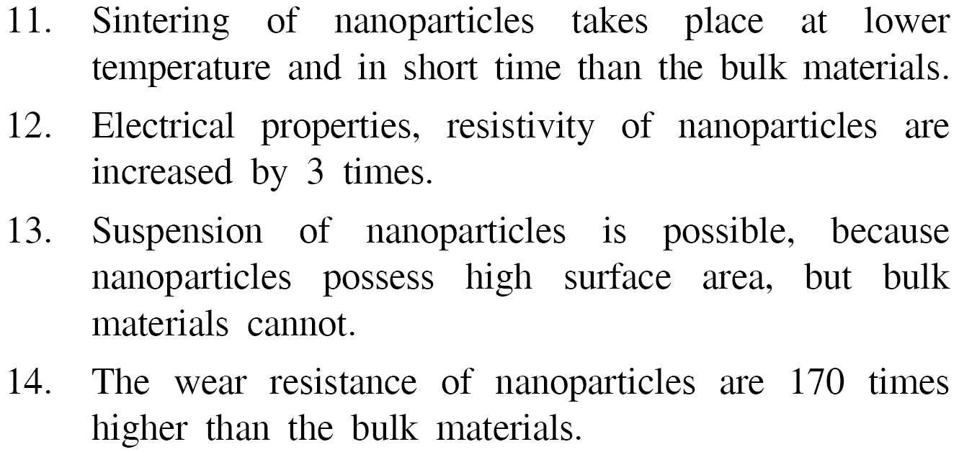

Slide 10
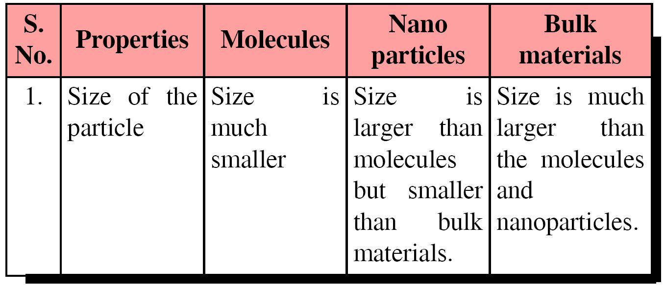

Slide 11
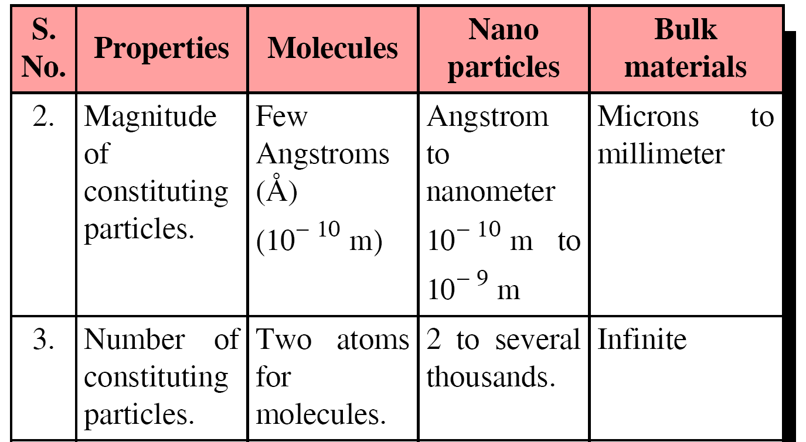

Slide 12
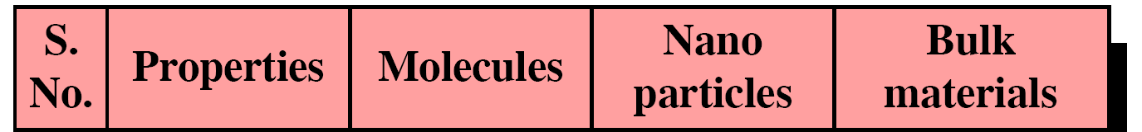
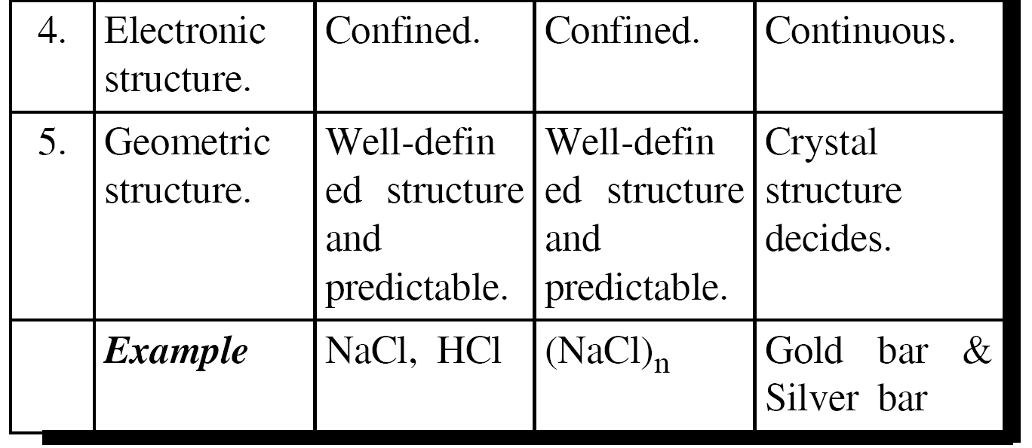

Slide 13

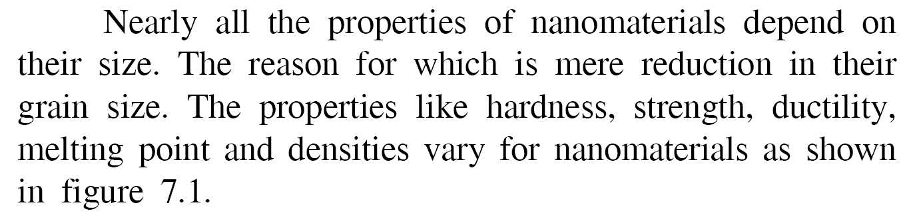

Slide 14
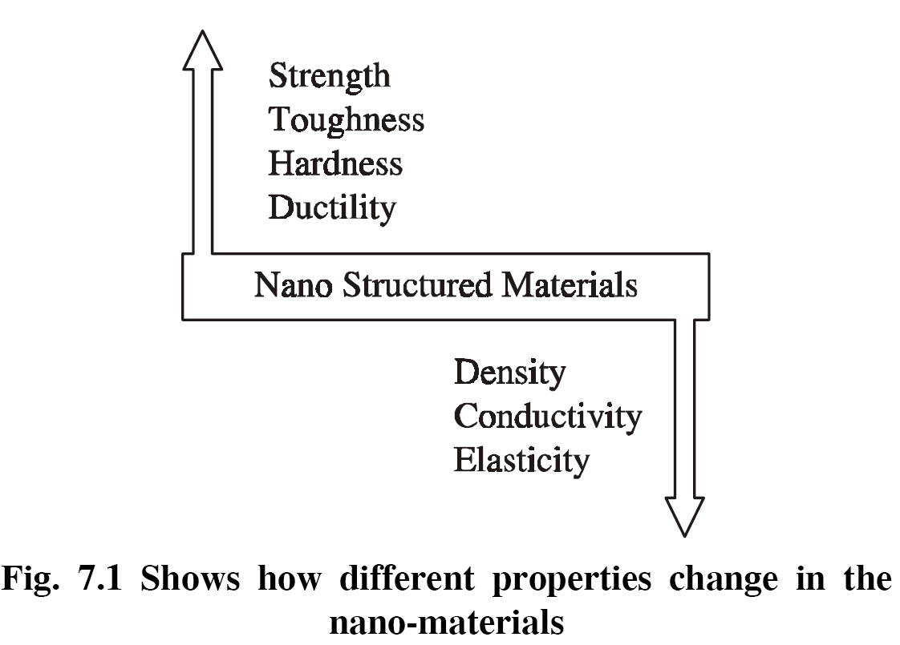

Slide 15
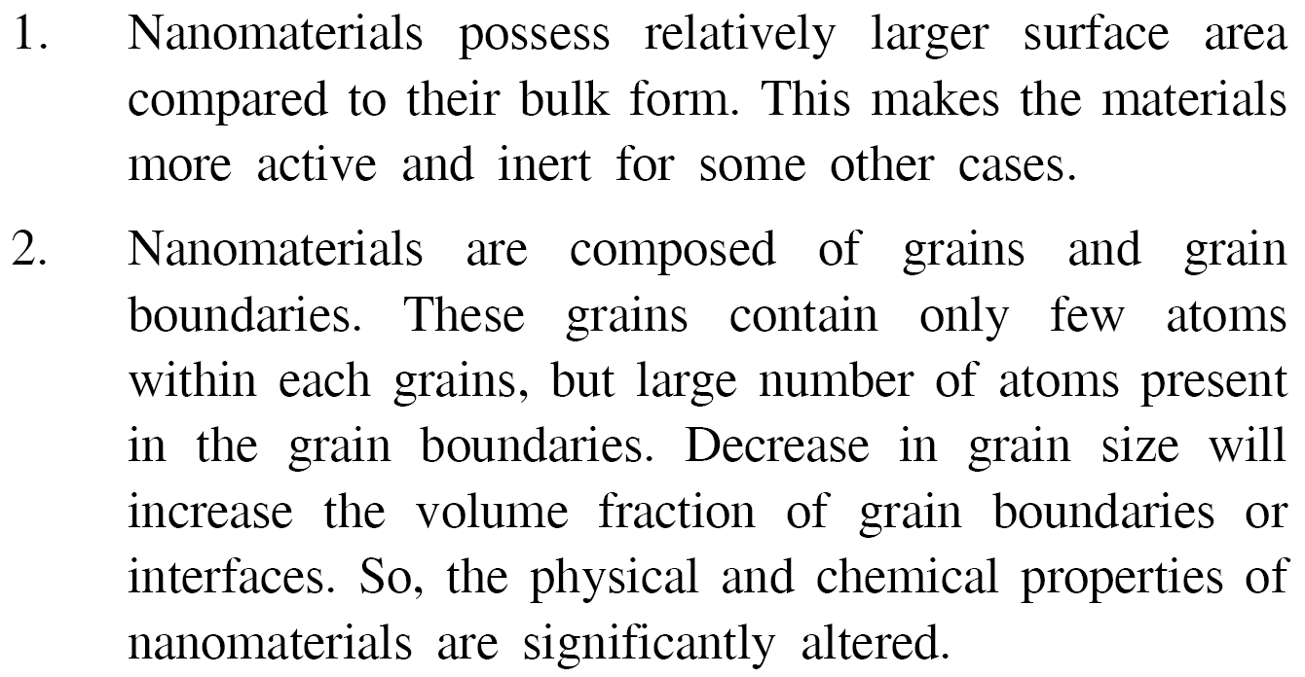

Slide 16
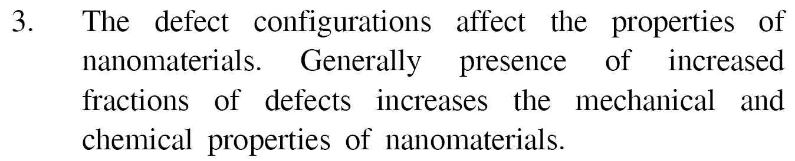
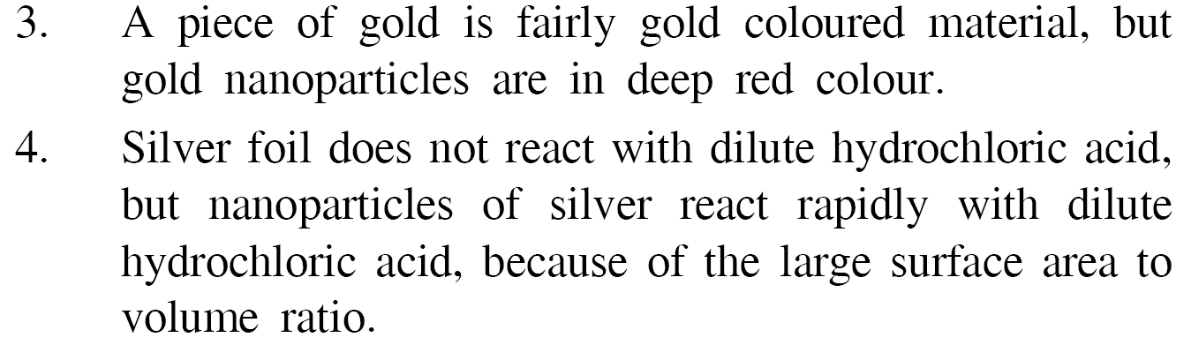
E amples

Slide 17

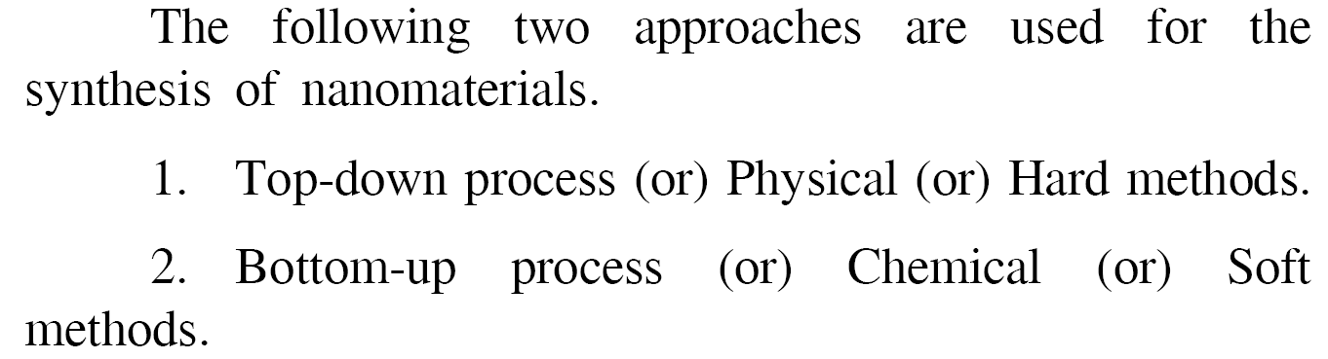

Slide 18
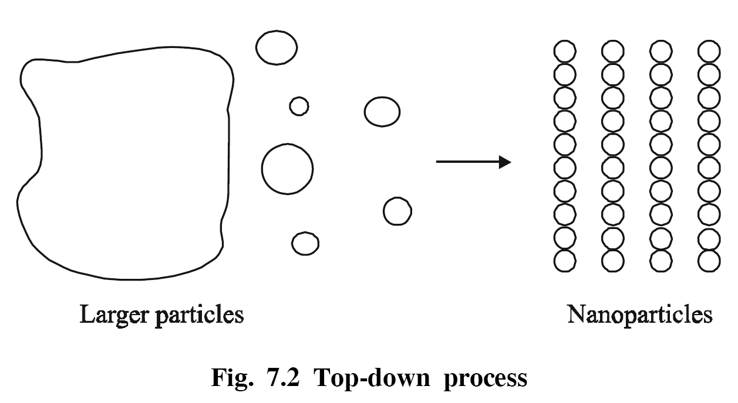

Slide 19
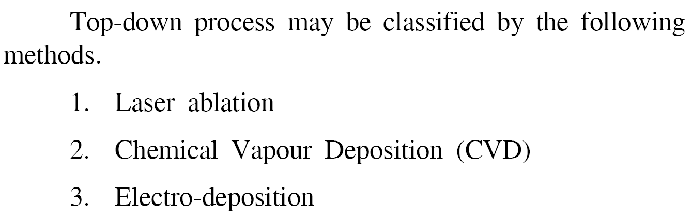

Slide 20

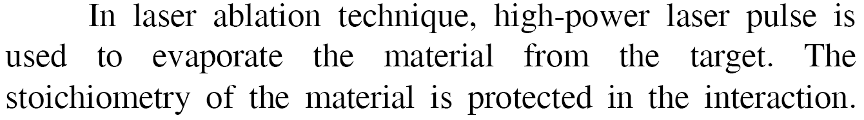

Slide 21
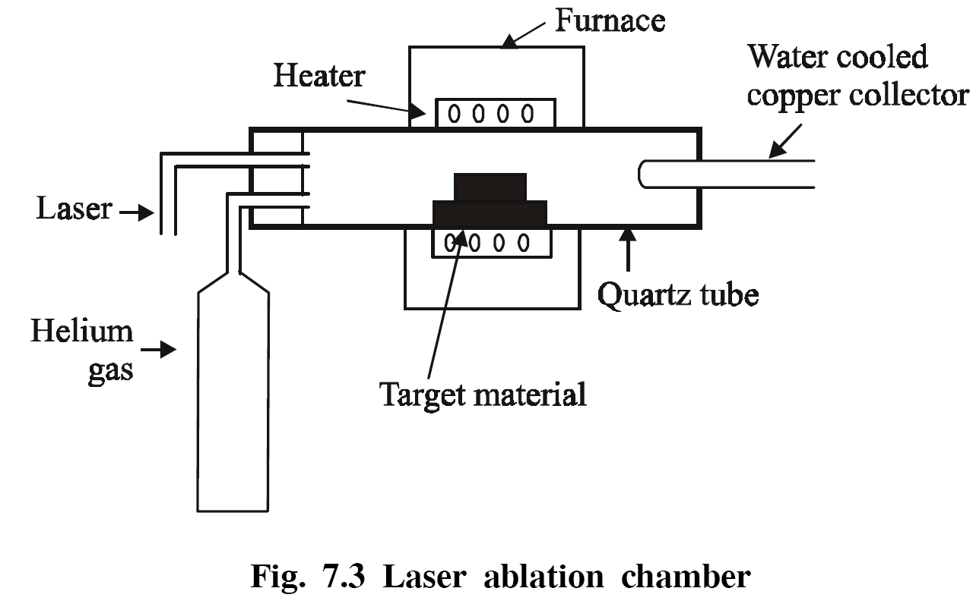

Slide 22
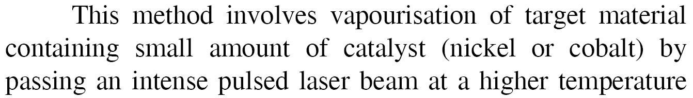
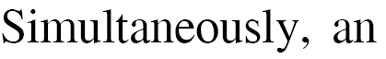
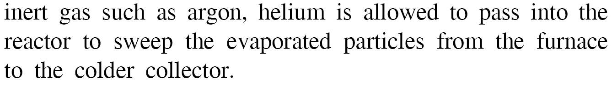

Slide 23

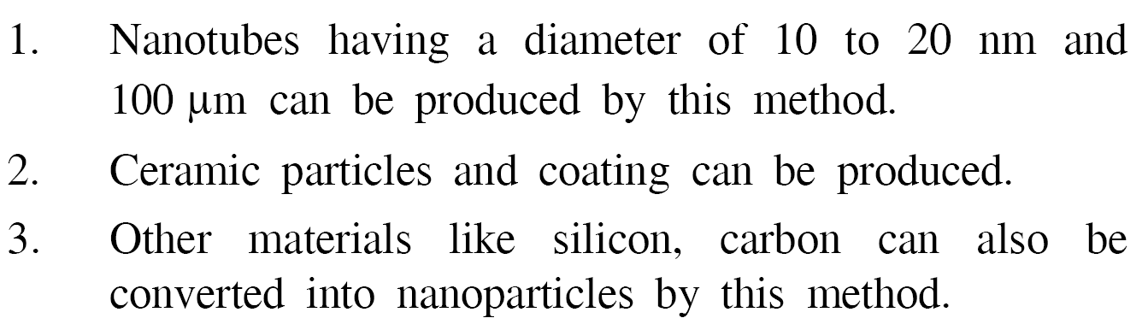

Slide 24

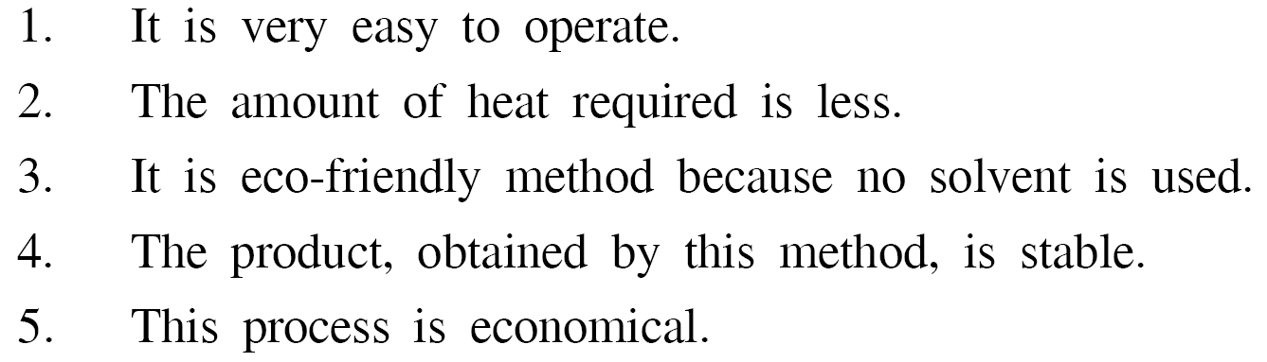

Slide 25
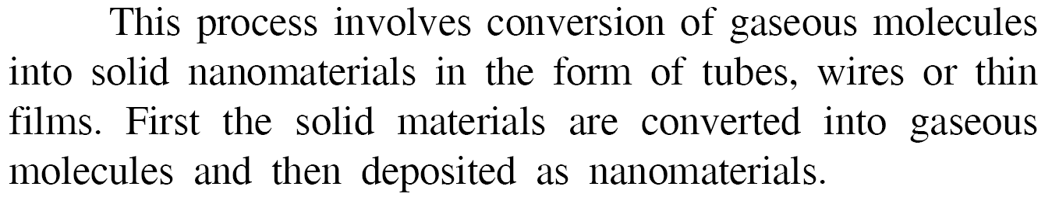
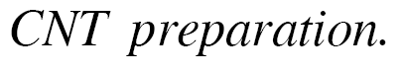
E ample

Slide 26
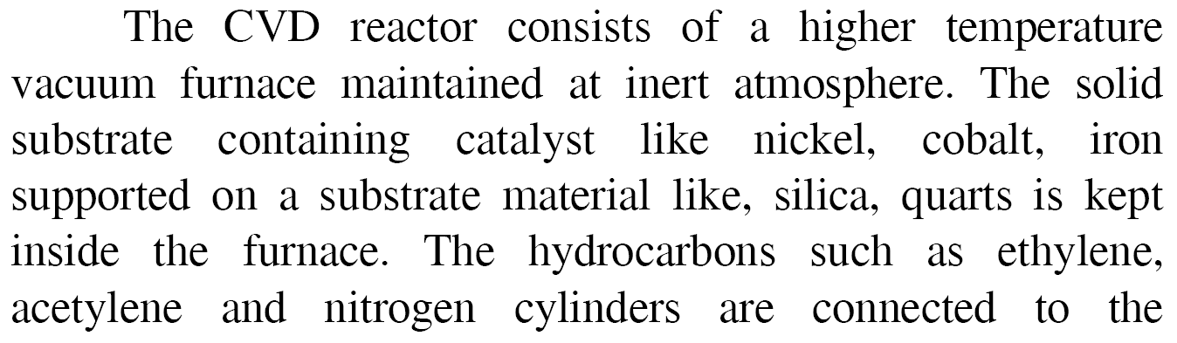
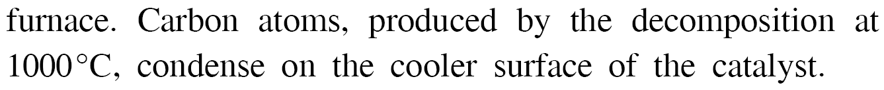

Slide 27
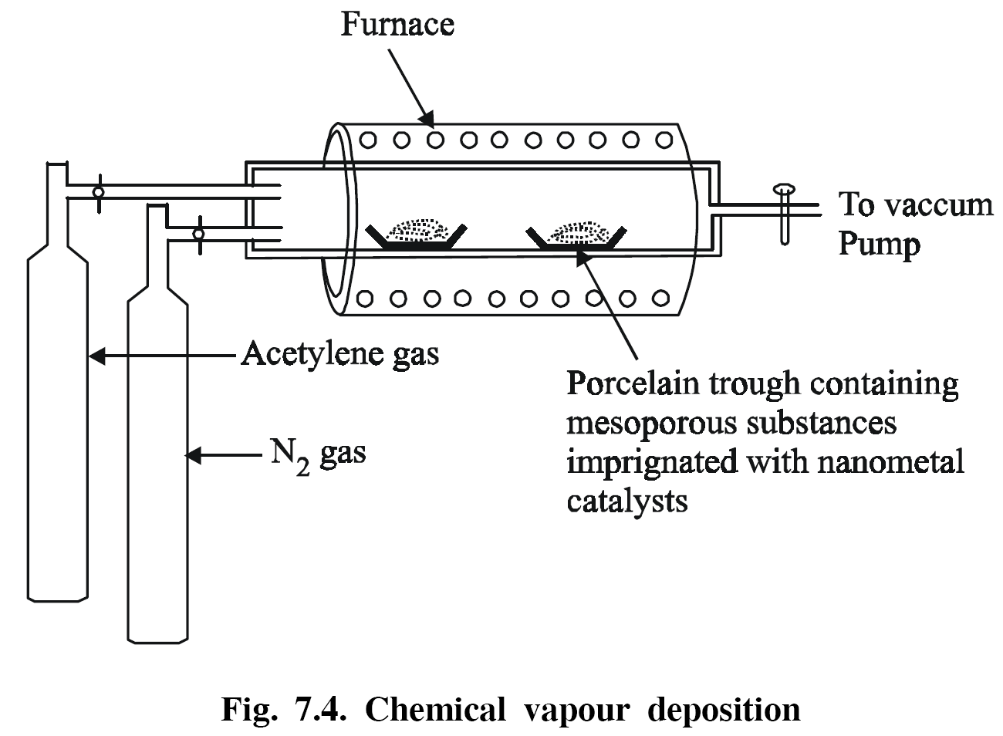

Slide 28

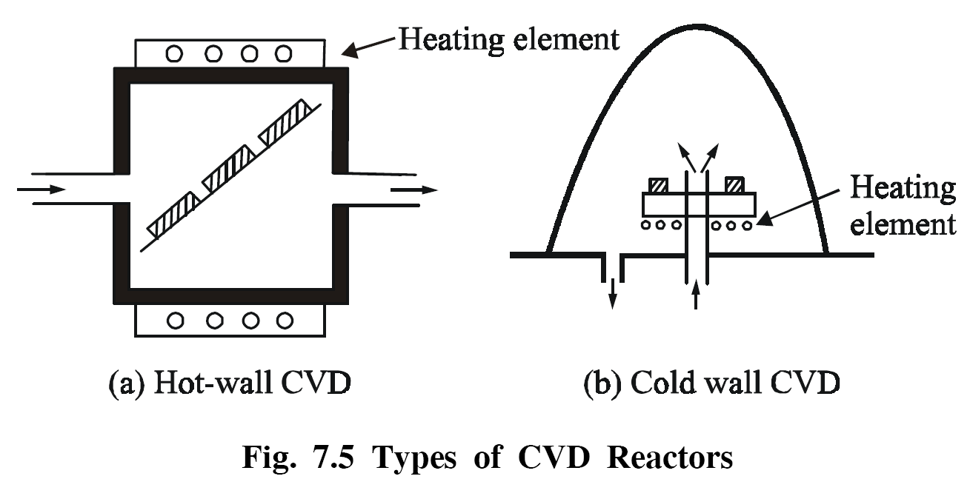

Slide 29

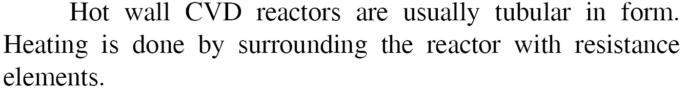

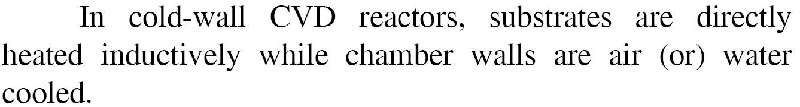

Slide 30

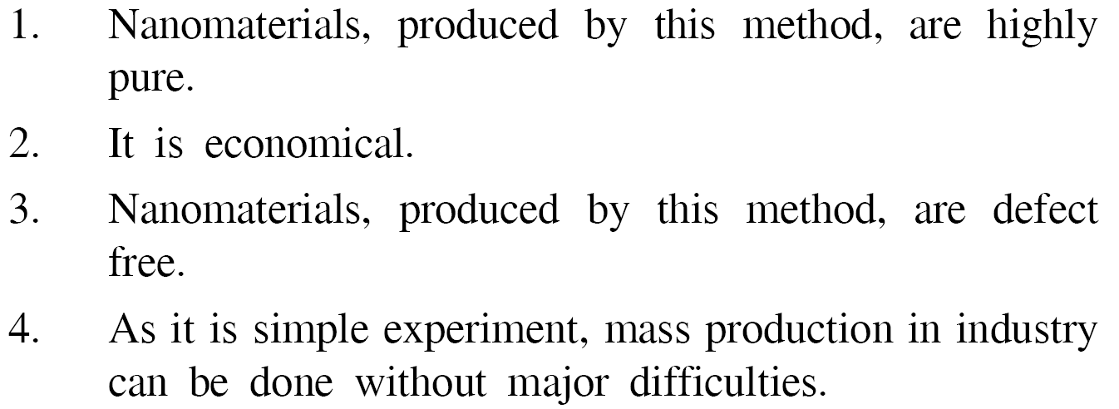

Slide 31

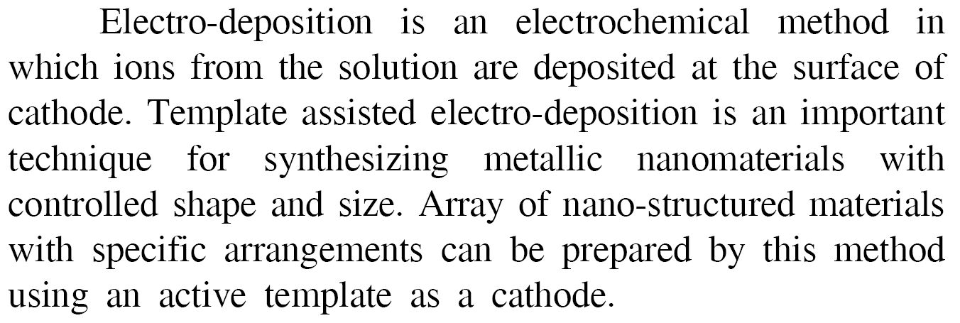

Slide 32
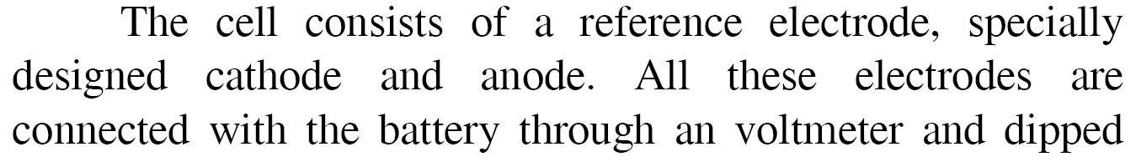
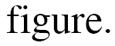
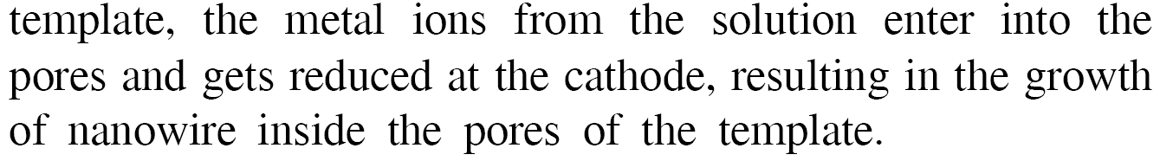

Slide 33
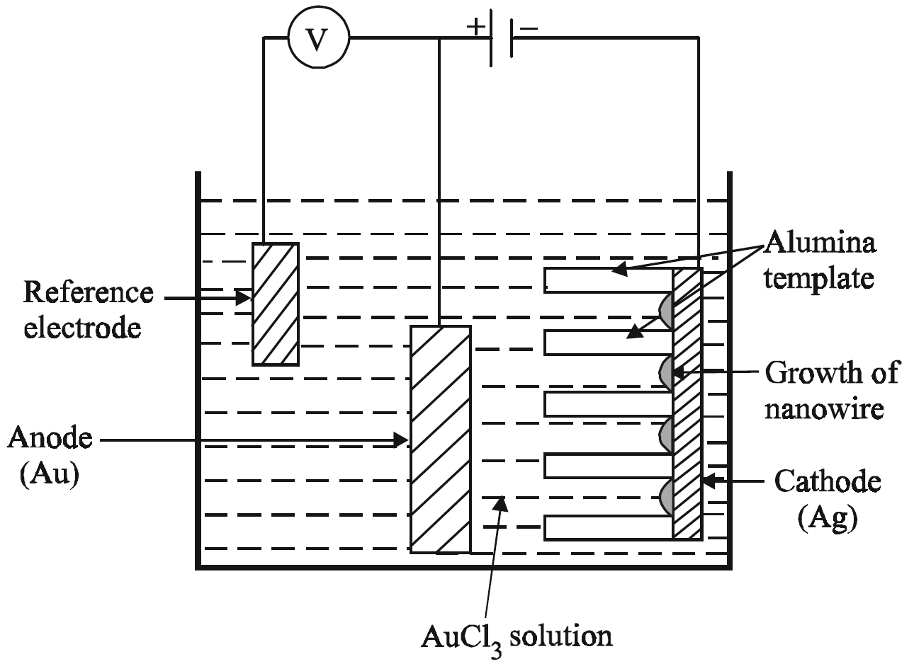

Slide 34
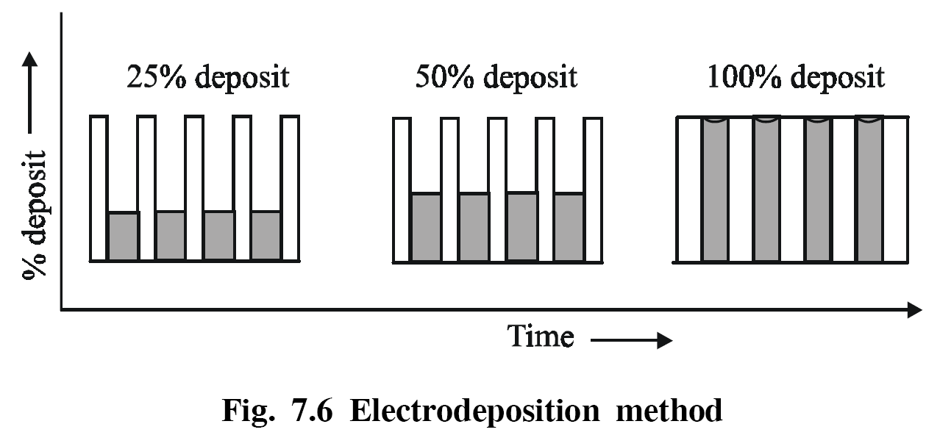
E ample

Slide 35
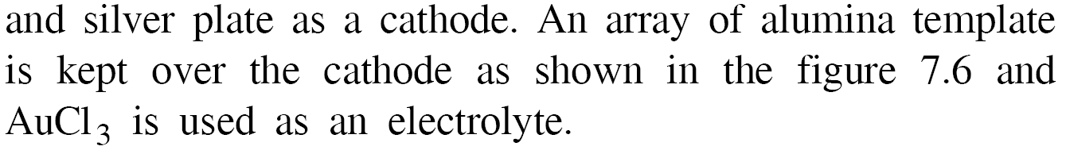
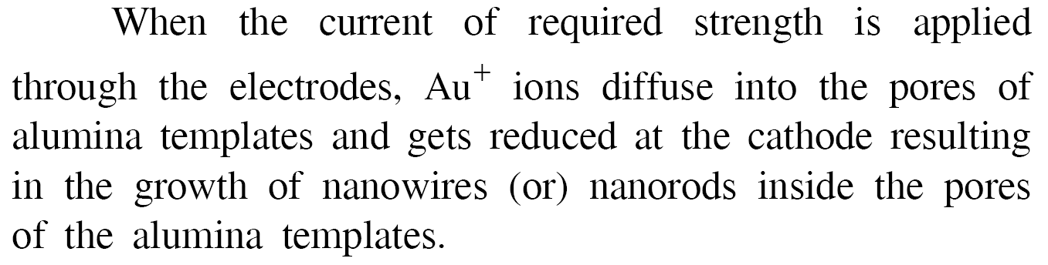

Slide 36
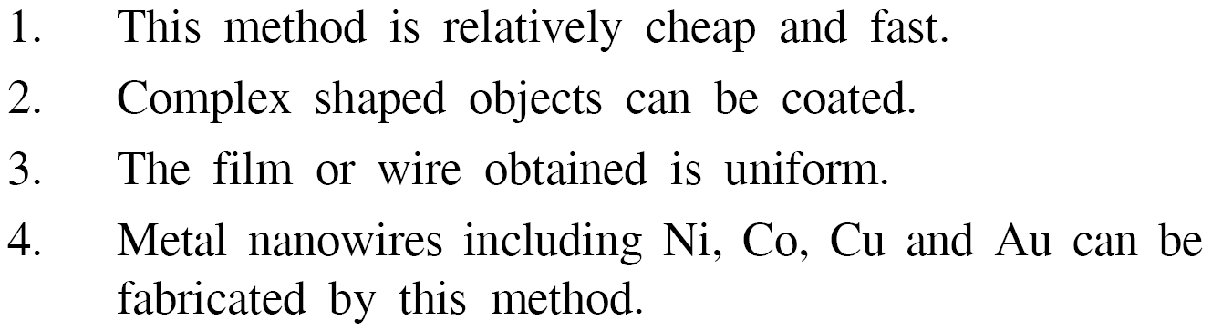

Slide 37



Slide 38




Slide 39


E amples

Slide 40



Slide 41

E ample

Slide 42



Slide 43






Slide 44


Slide 45





Slide 46

E ample

Slide 47


Slide 48




Slide 49


Slide 50



E amples

Slide 51


Slide 52



E amples

Slide 53



Slide 54



Slide 55


Slide 56




Slide 57





Slide 58


E amples

Slide 59



Slide 60


Slide 61



Slide 62



Slide 63




E amples

Slide 64




Slide 65





Slide 66


Slide 67



E amples

Slide 68



Slide 69


Slide 70



Slide 71



Slide 72





Slide 73





Slide 74


Slide 75




Slide 76




Slide 77


Slide 78




Slide 79


Slide 80



Slide 81



Slide 82


Slide 83






Slide 84


E ample

Slide 85



E ample

Slide 86



E ample

Slide 87




E ample

Slide 88



E ample

Slide 89





Slide 90





Slide 91



Slide 92


Slide 93


Slide 94



E ample

Slide 95




Slide 96



Slide 97



Slide 98




Slide 99



Slide 100


Slide 101


Slide 102


Slide 103


